Slide 1
Managing and Understanding Data, in R
Wk 1, Part 4
Notes:
Image from http://dmlcentral.net/blog/lyndsay-grant/understanding-education-through-big-data

Slide 2
Following Lantz’s Ch 2…
Vectors:
subject_name <- c("John Doe", "Jane Doe". "Steve Graves")
Error: unexpected symbol in "subject_name <- c("John Doe", "Jane Doe"."
> subject_name <- c("John Doe", "Jane Doe", "Steve Graves")
> temperature <- c(98.1, 98.6, 101.4)
> flu_status <- c(FALSE, FALSE, TRUE)
> temperature[2]
[1] 98.6
> temperature[2:3]
[1] 98.6 101.4
> temperature[-2]
[1] 98.1 101.4
> temperature[c(TRUE,TRUE,FALSE)]
[1] 98.1 98.6

Slide 3
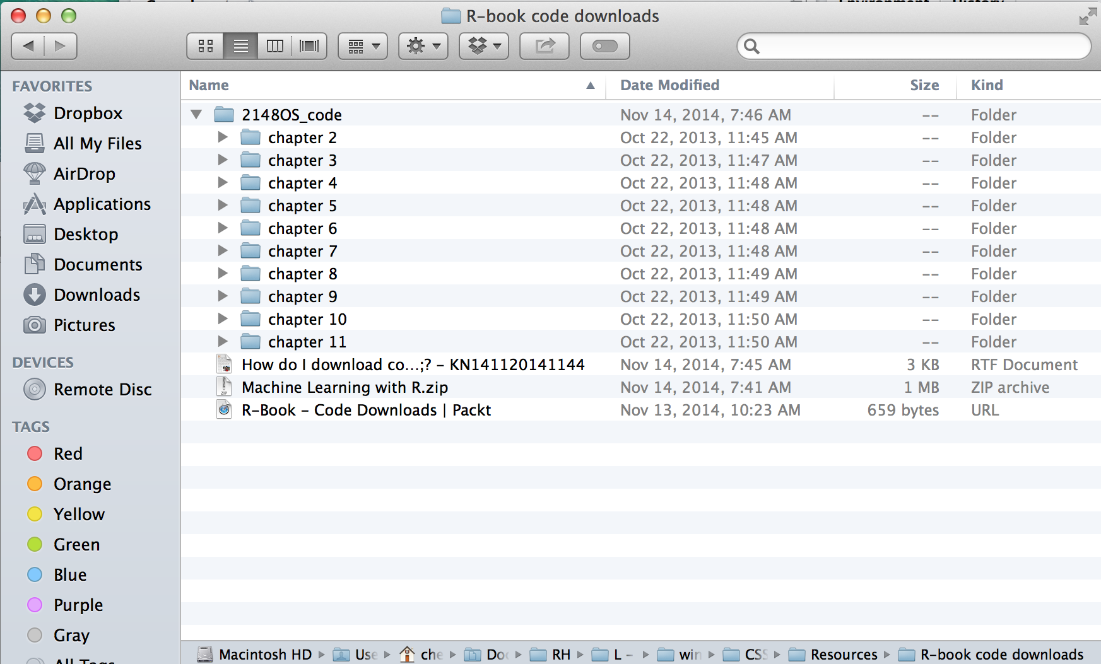
Downloading the sample code
It’s all in a zip file on Moodle:

Slide 4
Factors
> gender <- factor(c("MALE","FEMALE","MALE"))
> gender
[1] MALE FEMALE MALE
Levels: FEMALE MALE
> blood <- factor(c("O", "AB", "A"), levels = c("A", "B", "AB", "O"))
> blood
[1] O AB A
Levels: A B AB O
> subject1 <- list(fullname = sugject_name[1],)
Error: object 'sugject_name' not found
> subject1 <- list(fullname = subject_name[1], temperature = temperature[1], flu_status = flu_status[1], gender = gender[1], blood = blood[1])

Slide 5
Factors, cntd
> subject1
$fullname
[1] "John Doe"
$temperature
[1] 98.1
$flu_status
[1] FALSE
$gender
[1] MALE
Levels: FEMALE MALE
$blood
[1] O
Levels: A B AB O
> subject1[2]
$temperature
[1] 98.1
> subject1$temperature
[1] 98.1
> pt_data <- data.frame(subject_name, temperature, flu_status, gender, blood, stringsAsFactors = FALSE)
> pt_data
subject_name temperature flu_status gender blood
1 John Doe 98.1 FALSE MALE O
2 Jane Doe 98.6 FALSE FEMALE AB
3 Steve Graves 101.4 TRUE MALE A
> pt_data$subject_name
[1] "John Doe" "Jane Doe" "Steve Graves"
> pt_data[c("temperature", "flu_status")]
temperature flu_status
1 98.1 FALSE
2 98.6 FALSE
3 101.4 TRUE
> pt_data
subject_name temperature flu_status gender blood
1 John Doe 98.1 FALSE MALE O
2 Jane Doe 98.6 FALSE FEMALE AB
3 Steve Graves 101.4 TRUE MALE A

Slide 6
Matrices and arrays
Two dimensional data
Typical of how data is stored for R processing
Rows = examples
Columns = features / outcomes

Slide 7
Saving and loading data
> write.csv(pt_data, file = "pt_data.csv")
> usedcars <- read.csv("/Users/chenowet/Documents/Rstuff/usedcars.csv", stringsAsFactors = FALSE)
> str(usedcars)
'data.frame': 150 obs. of 6 variables:
$ year : int 2011 2011 2011 2011 2012 2010 2011 2010 2011 2010 ...
$ model : chr "SEL" "SEL" "SEL" "SEL" ...
$ price : int 21992 20995 19995 17809 17500 17495 17000 16995 16995 16995 ...
$ mileage : int 7413 10926 7351 11613 8367 25125 27393 21026 32655 36116 ...
$ color : chr "Yellow" "Gray" "Silver" "Gray" ...
$ transmission: chr "AUTO" "AUTO" "AUTO" "AUTO" ...
> summary(usedcars$year)
Min. 1st Qu. Median Mean 3rd Qu. Max.
2000 2008 2009 2009 2010 2012
> boxpolot(usedcars$price, main="Boxplot of Used Car Prices", ylab="Price ($)")
Error: could not find function "boxpolot"
> boxplot(usedcars$price, main="Boxplot of Used Car Prices", ylab="Price ($)")

Slide 8
Exploring data
> boxplot(usedcars$mileage, main="Boxplot of Used Car Mileage", ylab="Odometer (mi.)")
> hist(usedcars$mileage, main="Histogram of Used Car Mileage", xlab="Odometer (mi.)")
> sd(usedcars$price)
[1] 3122.482
> table(usedcars$year)
2000 2001 2002 2003 2004 2005 2006 2007 2008 2009 2010 2011 2012
3 1 1 1 3 2 6 11 14 42 49 16 1
> table(usedcars$model)
SE SEL SES
78 23 49
> plot(x = usedcars$mileage, y = usedcars$price,
+ main = "Scatterplot of Price vs. Mileage",
+ xlab = "Used Car Odometer (mi.)",
+ ylab = "Used Car Price ($)")

Slide 9
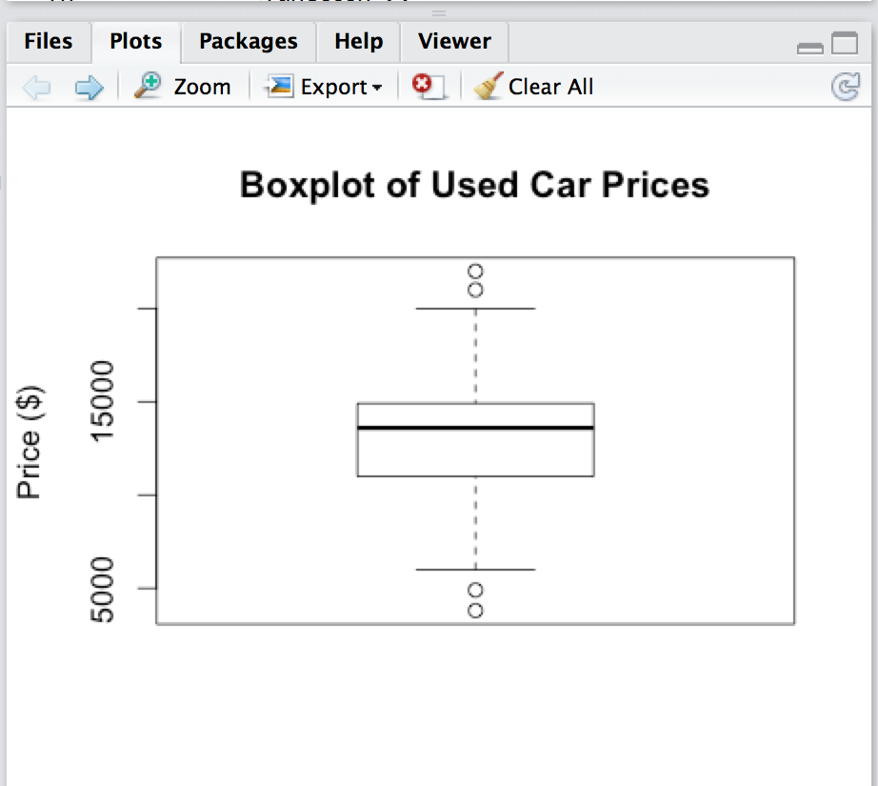
Plots
Boxplot:
Notes:
P 50 in Lantz

Slide 10
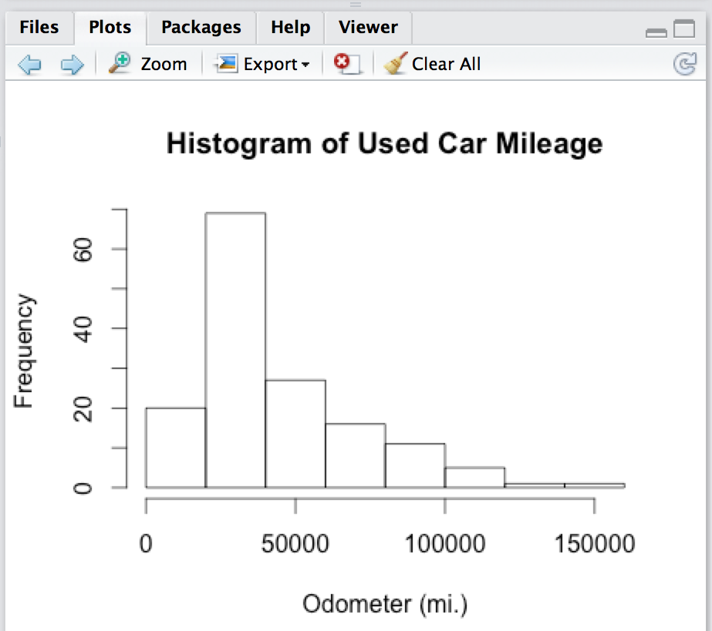
Plots
Histogram:

Slide 11
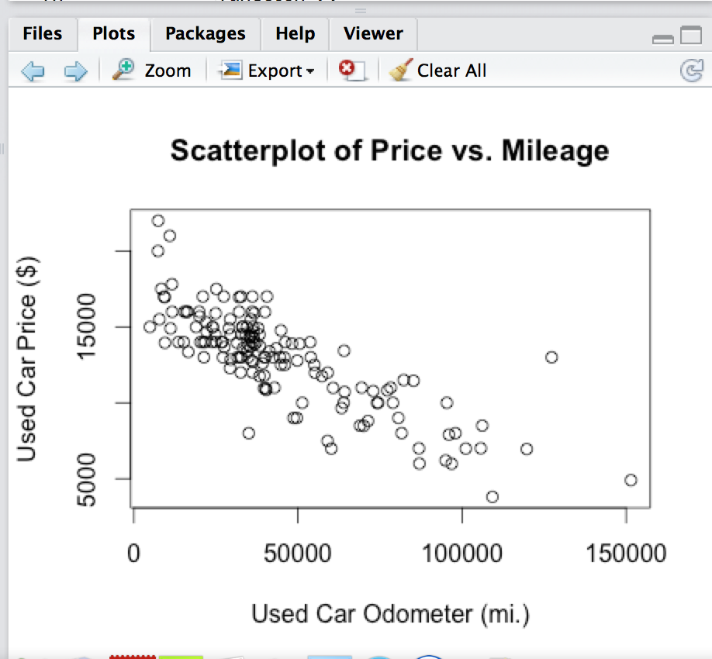
Plots
Scatterplot:

